Slide 1
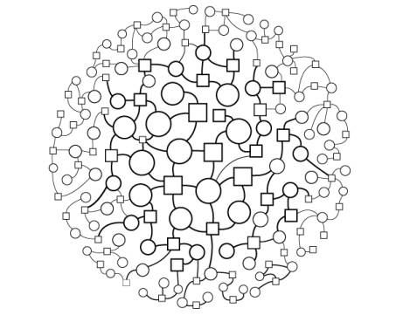
Energy-Efficient Mechanism ( AJIA)
for Packet Loss Recovery and Route Quality Evaluation
Faisal Alharbi
Jieli Chen
Mohammed Althubyani
Instructor: Dr.Tang

Slide 2
Outline
Problem & Main Solution
Detail Implementation - “Simulation”
Result Display & Analysis
Conclusion
Future Work

Slide 3
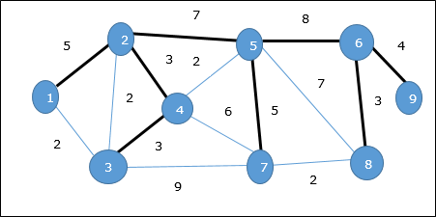
Our Research Problem and The Main Solution for it:
The reliability of real time emergency applications for IoT.
The goal of our research are sending the packet from node to other successfully.

Slide 4
Why we selected this topic?
the inclusion of the IoT concept into the emergency application will open new perspectives by identifying the ‘things’, achieving sensing tasks and building low cost and reliable solutions and services.
Fast response is required in critical situations (fire detection, terrorist attack, etc).
Because of that we need to improve the reliability of Internet of Things.

Slide 5
The Research Problem Solution
A reliable data transfer mechanism called AJIA (Adaptive Joint protocol based on Implicit ACK):
Based on implicit acknowledgements
Ensure low latency
Minimizing loss recovery cost by using localized data recovery among one hop neighbors

Slide 6
What is AJIA?
AJIA is protocol tackles the link failure and packet loss problem, by proposing a reliable and energy-efficient error control protocol in a limited computational resources environment.
The idea is when a node transmits a packet, nodes in its neighborhood overhear the packet transmission even if there are not the intended recipients, due to the broadcast nature of the wireless channel.

Slide 7
What is AJIA?
Using this overhearing characteristic instead of the acknowledgment messages to guarantee reliability in the network:
When a packet loss is detected, retransmission is carried out on the most reliable link between the node that sent the (lost) packet and its one-hop neighbors.
The reliability of links is defined through a metric based on the link history and the link quality indicator (LQI).

Slide 8
To achieve these goals we have taken a different approach in comparison to traditional end-to-end error recovery mechanisms, where only the final destination node is responsible for detecting loss and requesting retransmission.
We propose a hop-by-hop packet loss recovery mechanism, in which intermediate nodes also take responsibility for loss detection and recovery.
What is AJIA?

Slide 9
The Research Problem Solution
AJIA Algorithm Steps:
Initialization Networking Model Phase
Message Relaying
Lost Message Detection
Selective Recovery

Slide 10
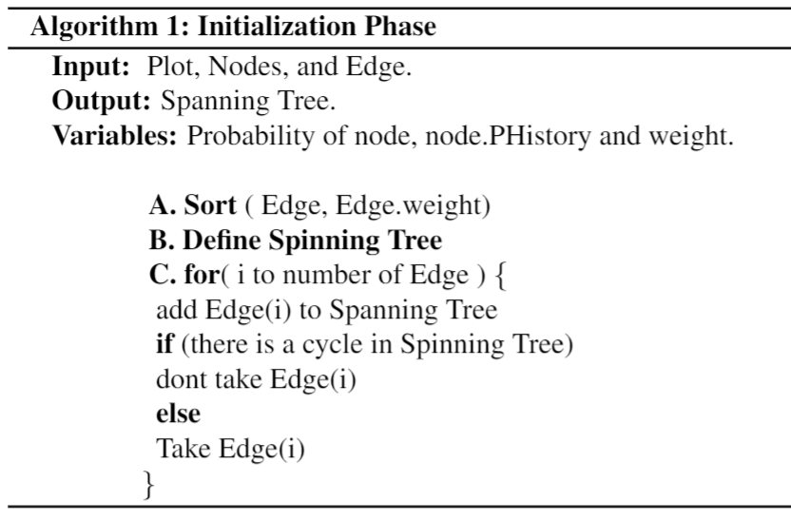
Initialization Networking Model Phase

Slide 11
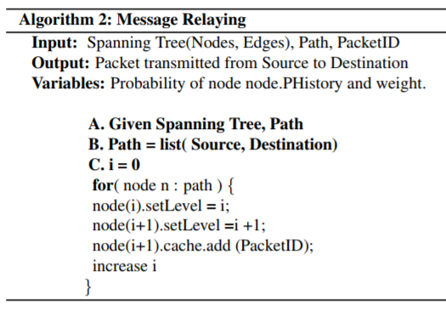
2. Message Relaying

Slide 12
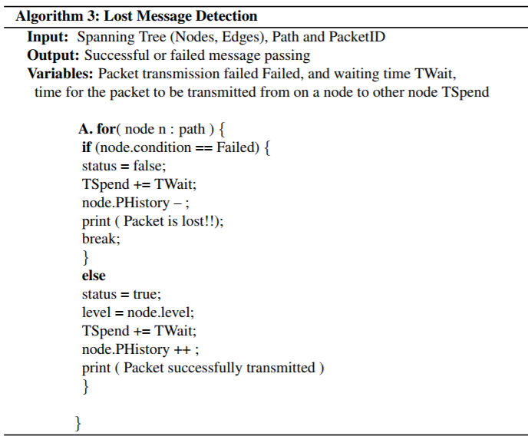
3. Lost Message Detection

Slide 13
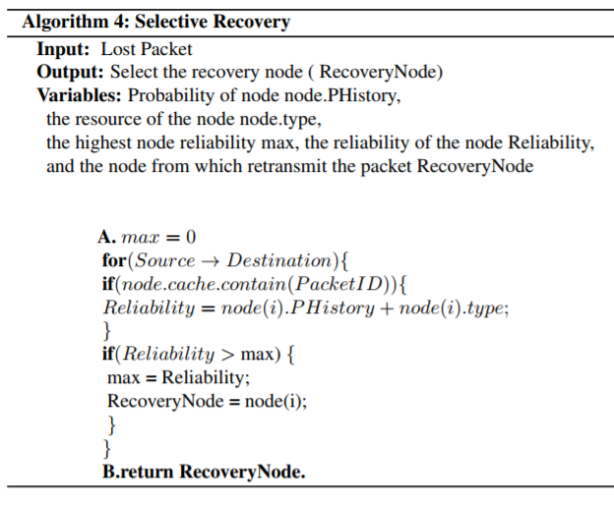
4. Selective Recovery

Slide 14
Implementation
Simulator Brief Description
Simulate the virtual network with sensing devices (mobile, laptop, PC and other wireless devices)
Simulate sending data packets and ACK messages within the virtual networking from different source and destination device
Simulate detecting loss or failure of data packets within data transmission in the virtual networking
Simulate selecting the best next hop in terms of costs for packet retransmission
Simulate retransmission continue until the packet arrive at the destination devices

Slide 15
Implementation
Assumptions in Simulation
The network is composed of heterogeneous objects such as sensors, mobile phones, etc
The objects which have different transceiver characteristics are randomly distributed in a specific given environment
All the devices have sufficient resources to perform sensing, computing, and communication activities
Data packets are randomly generated and transmitted to the sink node
Nodes are stationary during their lifetime
Nodes record the performance of the link between themselves
The collection of data from a node to the sink must be completed within a specified time

Slide 16
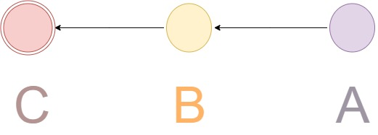
Implementation
Assumptions in Simulation (Cont.)
The collection of data from a node to the sink must be completed within a specified time
If the packet does not reach the sink within this time limit, it is dropped and considered as it has been lost.
Assume to have a symmetrical channel, so that both the endpoints of the channel will keep an identical history of link performance
Both two sides of the link count of the number of states (up/down)

Slide 17
Implementation
Simulator
AJIA mechanism computing in Java following the design of AJIA algorithm
Graph and networking Establishment in Python NetworkX
simulations are performed on a MacBook laptop with 2.4 GHz Intel Core i7 processor
Two Setup
Setup one: 10 nodes within 100*100 area (simulate as a meeting room environment or home environment), Timeout Twait 10 secs
Setup two: 25 nodes with 200*200 area (simulate as a small working office area), Timeout Twait 20 secs

Slide 18
Implementation
Steps:
Build A Networking Environment
Set an area within a specific boundary (width, length)
Add Nodes
Initialize attributes of each node ( id, Phis, x, y, cache, type)
Add Edges
Build a complete graph for the above given nodes
Init attributes of each edge (source node, destination node, weight)

Slide 19
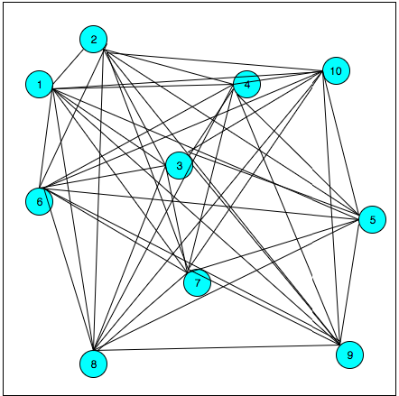

Slide 20

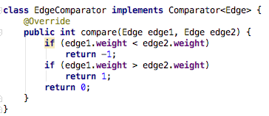
Implementation
Steps:
2. Build Spanning Tree (kruskal Algorithm )
Sort all the edges in non-decreasing order of their weight.

Slide 21
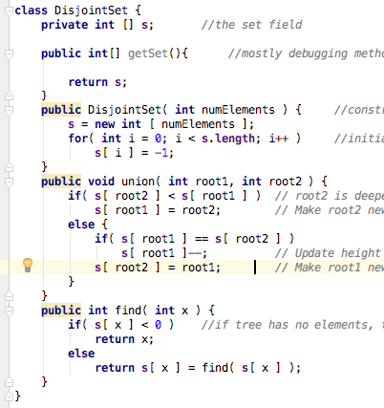
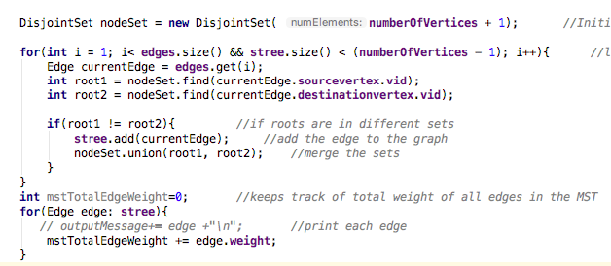
Implementation
Steps:
2. Build Spanning Tree (kruskal Algorithm )
Pick the smallest edge. Check if it forms a cycle with the spanning tree formed so far. If cycle is not formed, include this edge. Else, discard it; Repeat step#2 until there are (V-1) edges in the spanning tree.

Slide 22
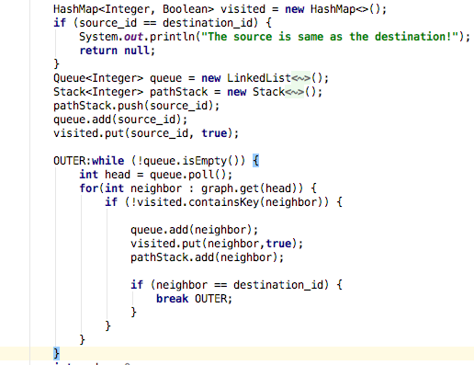
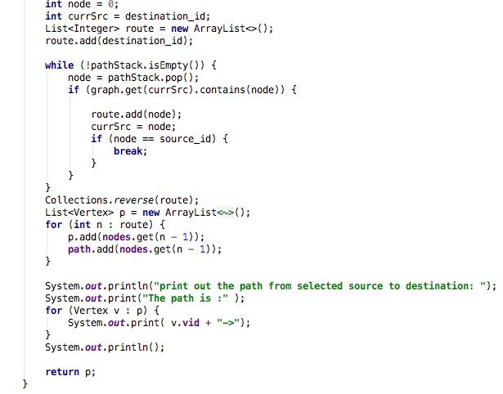
Implementation
Steps:
3. Get the path for the given source and destination

Slide 23
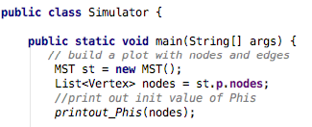
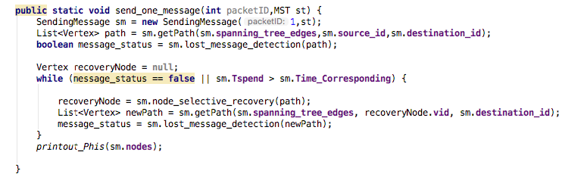
Implementation
Steps:
4. Packets relay
5. Loss detected, then find the best recovery source node in terms of cost

Slide 24
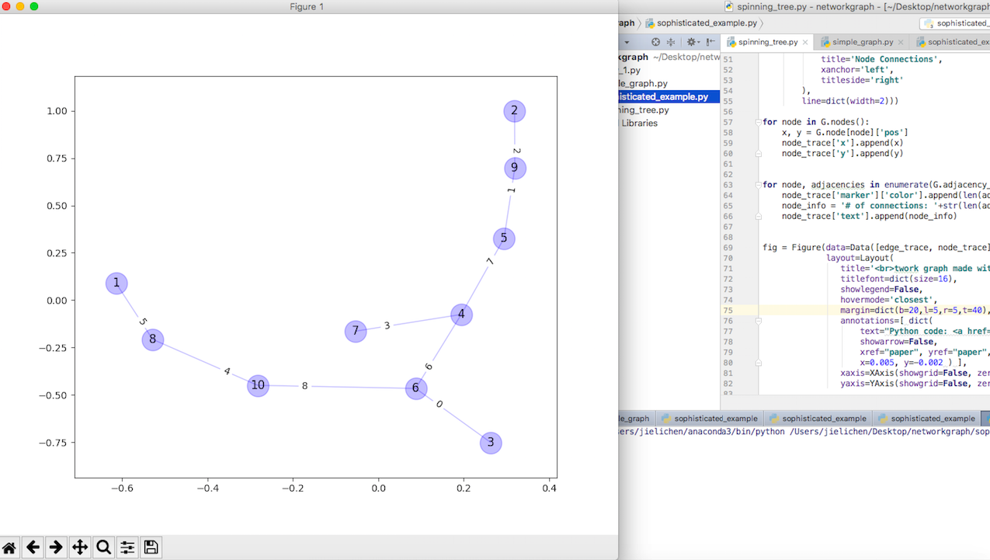
Result Display and Analysis
Model 1:
10 nodes with 100* 100 environment within 10 secs
Sending 10 packets from different sources and destinations by 2 rounds

Slide 25
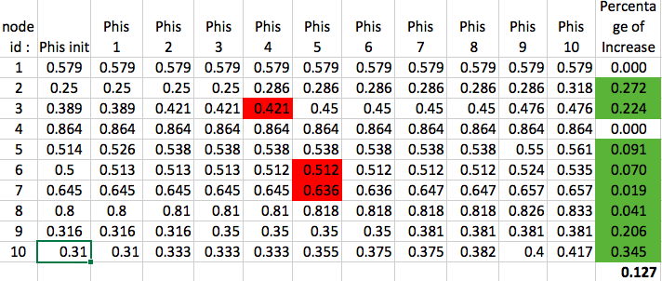
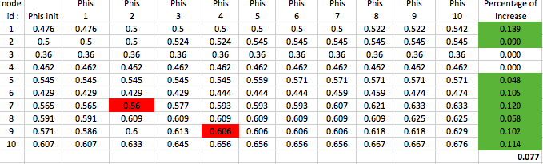
Result Display and Analysis
Model 1:
10 nodes with 100* 100 environment with 10 secs
Sending 10 packets from different sources and destinations by two rounds
80% nodes increase Phis
Increase Percentage is 11.2 % average

Slide 26
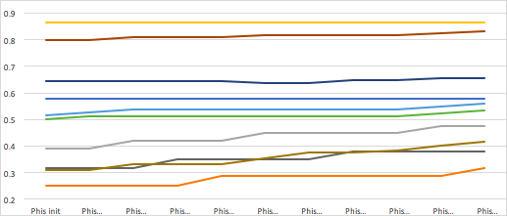
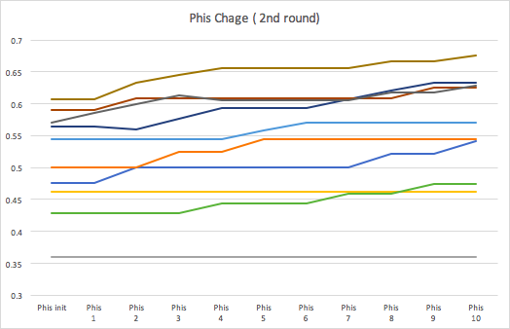
Result Display and Analysis
Model 1:
10 nodes with 100* 100 environment
Sending 10 packets from different sources and destinations by two rounds
The Phis will keep increasing with the number of packets sent in the networking

Slide 27
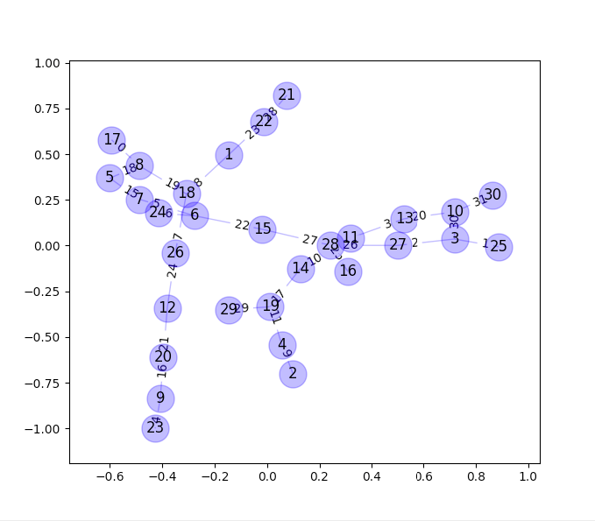
Result Display and Analysis
Model 2:
25 nodes with 200* 200 environment within 20 secs
Sending 10 packets from different sources and destinations by 2 rounds

Slide 28
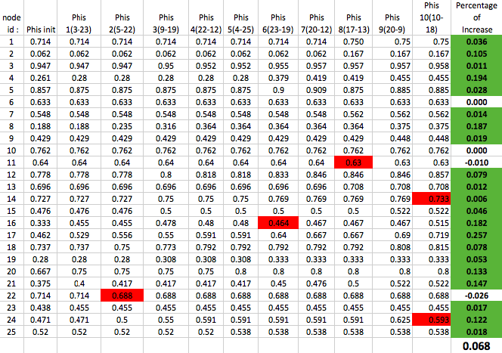
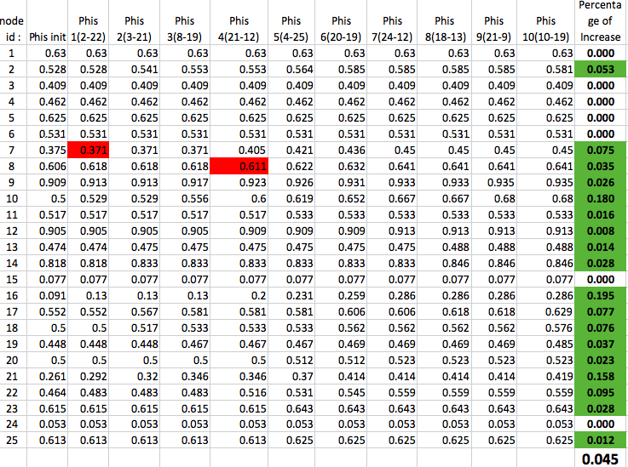
Result Display and Analysis
Model 2:
25 nodes with 200* 200 environment within 20 secs
Sending 10 packets from different sources and destinations by two rounds
82% nodes increase Phis
Increase Percentage is 6.8% and 4.5%

Slide 29
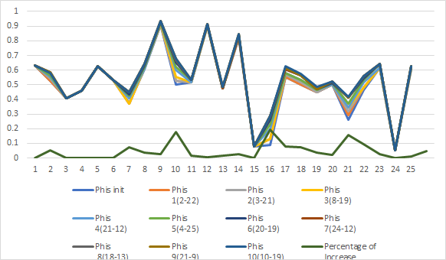
Result Display and Analysis
Model 2:
25 nodes with 200* 200 environment
Sending 10 packets from different sources and destinations by two rounds
The Phis will keep increasing with the number of packets sent in the networking

Slide 30
Conclusion
The AJIA mechanism increases the reliability of 82% links of IoT
The more packets are sent to a specific IoT environment, the high reliability the links will be by AJIA mechanism
The AJIA mechanism is more suitable and effective to small local IoTs like meeting room or home with less than 10 sensing devices, which has 11.2% reliability increase

Slide 31
Future Work
Considering energy efficiency when calculating the reliability
Considering about The Link Quality Indicator (LQI)

